Slide 1
Privacy
The right to be left alone.

Slide 2
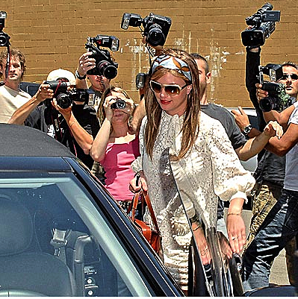
Privacy
Privacy is the right to be left alone, to control unwanted publicity.
It is in direct opposition to the business of the media: they do not want to leave people alone.

Slide 3
Privacy
The right to privacy is a central issue of many mass media ethics cases.
Invasion of privacy may be physical, sticking a microphone into someone’s face, or it may be publishing embarrassing personal information.

Slide 4
Privacy
News people can invade privacy.
Advertisers can invade our privacy as well, by aggressively seeking our attention.
Government can invade our privacy.
The internet can invade our privacy.

Slide 5
Privacy
These areas may conflict. For example, is it all right for satellites to collect information about your backyard activities?
Is is okay to require job applicants to give a urine sample under surveillance for drug testing?
Is it all right to use full-body scanning technology in airports?
Is it okay to use Facebook to screen job applicants?

Slide 6
Privacy
Many people worry that privacy is invaded more and more.
Government and advertisers collect enormous databases regarding our personal habits.
Cameras and videos are everywhere, and vids can be uploaded to the whole world in minutes.

Slide 7
Privacy
Is it legitimate for media to collect information about politicians’ private lives to expose purported immoral (but not illegal) behavior?
Do politicians have no ethical right to privacy? (Even if they have little legal right.)
The Gary Hart incident set a new ethical standard, but two thirds of Americans thought he was treated in an unethical manner by the media. [http://www.youtube.com/watch?v=XmKFLVcagSg]

Slide 8
Privacy
Why do we value privacy?
It’s a modern development—Colonial America had a different perception of need for privacy: drinking, eating, sleeping facilities were shared at inns.
It’s a mass media development—as mass media grew, privacy become more difficult to protect.

Slide 9
Privacy
Privacy is a matter of personal autonomy: we have power over our own lives when personal information is kept private.
When the media invade our privacy, they damage our right to control what others know about us.

Slide 10
Privacy
In addition to the idea of personal control, we wish to control our privacy to keep use from ridicule.
Society is not tolerant of some behavior it deems deviant.
Gays, atheists, Muslims are among groups whose members may wish to keep their status secret.

Slide 11
Privacy
Privacy gives us the opportunity to control our reputations.
Most of us do care what others think.
Knowledge, again, is power, and most people wish to avoid publicizing behavior society might not approve of.

Slide 12
Privacy
Our right to privacy helps us to regulate the degree to which we interact with others.
You don’t have to be friendly if you don’t want to.
Laws against trespassing recognize our right to peace and quiet.

Slide 13
Privacy
Yet we are social beings as well as private individuals.
The right to privacy conflicts with other rights, such as truth or justice.
And against our natural curiosity.

Slide 14
Privacy
Truth and others basic virtues may date to antiquity. Privacy, as we noted, does not.
Aristotle and Plato never mentioned it.
People were expected to be involved in public affairs.
A “private person” was not a good citizen.

Slide 15
Privacy
The idea of privacy did gain respect in England, as landlords found retreat from the world in their manors.
The idea of religious privacy became a founding principle of Colonial America: privacy of one’s conscience.

Slide 16
Privacy
The press before the 1830s had little interest in personal matters.
News was built on ideas, commentary and opinion.
The idea of celebrity didn’t exist. No one cared about personal behavior.

Slide 17
Privacy
The growth of urban America and mass media created crowded cities with little physical privacy.
The media adapted by offering material appealing no longer to the intellectual “elite” readers, but to “the masses.”
The publications which still appeal to the elite today, such as Harpers or Atlantic magazines, have a small readership.

Slide 18
Privacy
Newspaper content attracting a larger audience appealed to the emotions, to sensationalism: the foibles and antics of public and private people. The rich and famous. The sex and scandals.
The old elite loathed the stuff. And were often the victims.

Slide 19
Privacy
As privacy became more and more something the media hoped to reduce, it became more and more of value.
The ethical question became intrusion versus newsworthiness.
Legally privacy was not addressed until the beginning of the 20th century.

Slide 20
Privacy
Privacy laws today rest on these concepts most applicable to the media:
Intrusion.
Private facts.
Appropriation.

Slide 21
Privacy
The law seems to indicate media people have an ethical duty to respect privacy, unless the person has decided to relinquish that privacy.
But law is not ethics, and media people have wide latitude to gather information under U.S. law.

Slide 22
Privacy
Those who enter the public arena may be held to public scrutiny. But is it ethical to consider all private aspects to be fair game?
We may consider a standard that the revelation relate to the person’s public performance or image.
This may be difficult: Is the president’s religion, for example, a matter worth considering as fitness for public office? What about his marital status? His extramarital behavior?

Slide 23
Privacy
The private sexual activities of a celebrity or politician is certainly something a lot of people would like to read about.
But does that constitute “the people’s right to know?”

Slide 24
Privacy
So what is newsworthy?
Is public curiosity a good ethical standard?
The law has said any activity that takes place in a public place can be reported.
But we all can think of private moments that may take place in public places. Is it ethical to photograph such behavior?

Slide 25
Privacy
Consider such private moments, nudity, or emotion. What does ethics say about public decency?
If we consider media people to be representatives of the public, don’t we have the same ethical responsibilities as the public?
Or do we have a special right as professional journalists?

Slide 26
Privacy
What if the photo were newsworthy. The images below are famous; the first of the 1995 Oklahoma City bombing won a Pulitzer prize.
The second from 2006 is from the Abu Ghraib prison series showing apparent torture of prisoners by U.S. troops.

Slide 27
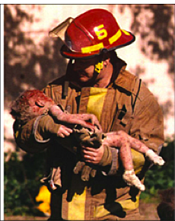
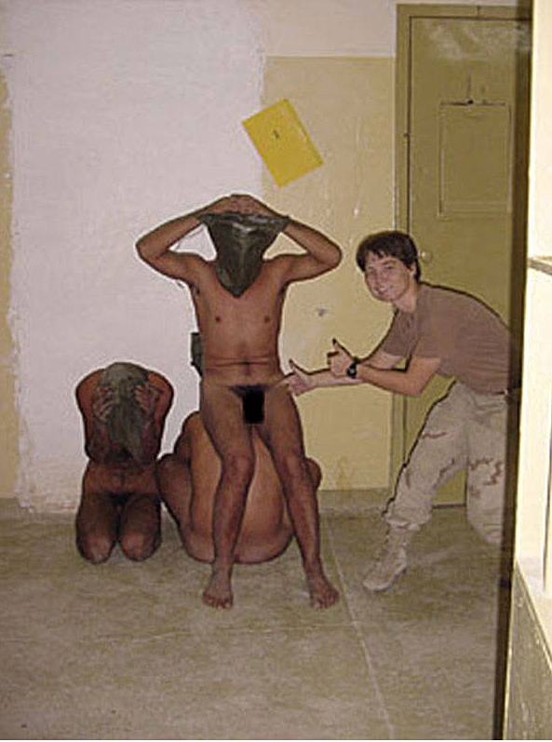
Privacy

Slide 28
Privacy
Is the naming of a rape victim a matter of public interest?
Are names of people convicted of DUIs public interest?
Are names of people in divorces and bankruptcies public interest?
What about names of people who are caught with prostitutes? What about names of the prostitutes?
All these are difficult ethical questions media people consider.

Slide 29
Privacy
Other special considerations journalists must consider:
Publicity of a contagious disease. For example, publicity of HIV or AIDS victim—at what point should it be made public? The mayor? The president?
Do we note a physical disability or mental illness? These still stigmatize the victim.

Slide 30
Privacy
Do media publicize homosexuality? Gay people still face stigma in society.
In a Washington case, eight people died in a fire at a gay nightclub. They had been watching gay X-rated films. Some of the victims had wives. Should names be published?
Washington Post did not. Washington Star did.

Slide 31
Privacy
Traditionally rape victim names have not been published in the United States, unless also murdered.
Some journalists argue this is outdated, the idea that “a woman must be protected.”
They note in all court cases the accusers and accused must be known.
Others say it would further traumatize the victim, and make her less likely to come forward.

Slide 32
Privacy
The media have generally not published names of juvenile offenders. But the Supreme Court ruled in 1979 that they did have the right to.
Those against publication argue it impedes rehabilitation.
Others argue it’s a matter of public importance, and juveniles should not be shielded from the consequences of crime.

Slide 33
Privacy
Suicide: the idea that people have the right to die with dignity has kept media often from publishing the cause of death in many cases.
But is this something the public has the right to know? Would such publication reduce the stigma of suicide, encourage people to get help?

Slide 34
Privacy
How should media collect information?
Is it ethically legitimate to have secret cameras record people’s activities on public property? Most of us have accepted that.
Some journalists have argued that secretly tape recording someone is no worse than a reporter holding a notebook, if they know they’re talking to a reporter.

Slide 35
Privacy
What ethical responsibility do reporters have in accidents and tragedies?
Is it okay to interview victims?
Is it okay to interview victim’s parents?
Is it okay to photograph victims in anguish?

Slide 36
Privacy
What about “ambush” interviews? That is, catching people off guard on the street and peppering the person with questions?
What about paparazzi-style photos of celebrities? Is it ethical to use a telephoto lens to capture a celebrity on a faraway public beach?

Slide 37
Privacy
Ethical codes tend to say little specific about privacy, something that might help us to answer these questions.
Values to consider when weighting privacy issues include:

Slide 38
Privacy
Respect for persons. If you believe individuals deserve some level of respect, you can’t just argue “people’s right to know.”
Social utility. What is important for the public to know, and what is sensationalism?
Justice, one of Ross’s duties: “What people deserve.” How much privacy does a person deserve in a particular circumstance?

Slide 39
Privacy
Nevertheless, the search for answers to the question of privacy is one of the most challenging questions faced by people in all areas of professional media.
Often the herd mentality takes over, and journalists regret their choices later. Competition and money become powerful motivators.
But ethical standards ask us to stop and consider beyond those issues of the moment.

Slide 40
Privacy
A case study from 1987 provides a shocking example of a decision journalists must make.
The state treasurer of Pennsylvania, Robert Dwyer, was convicted of taking a bribe.
He called a news conference, again declared his innocence.
Then he did something else in front of the cameras. He put a gun in his mouth and pulled the trigger.

Slide 41
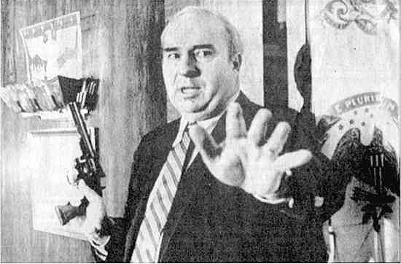
Privacy
There was no question this man was a public official, and so had no legal rights to privacy, even in suicide.
But what ethical right did the media have to broadcast this?

Slide 42
Privacy
In fact, response was varied. The majority stopped short of showing the suicide. A minority showed the whole tape.
Right to privacy seems to have become less and less possible, however, with the internet. If you really want to see something, you can find it.
That said, this is an ethics class for people whose job will be to gatekeep the media. We should not control the internet. Or should we?

